Slide 1
Cloudius Systems presents:
NoSQL goes NATIVE
Raphael Carvalho

Slide 2
Who am I?
Raphael Santana Carvalho
Work at ScyllaDB
Kernel programming;
File System;
Classical music.

Slide 3
Glauber Costa
KVM, Containers, Xen
Nadav Har’EL,
Nested KVM
Scylla
Avi Kivity KVM originator
Pekka Enberg,
kvm, jvm, slab
Dor Laor, Former kvm project mngr
Developers distributed across 12 countries.

Slide 4
Scylla: A new NoSQL Database
Capable of 1,000,000 operations per second
PER NODE
With predictable, low latencies
Compatible with Apache Cassandra

Slide 5
RESULTS: THROUGHPUT/SCALE UP

Slide 6
AGENDA
Introduction to NoSQL
About Apache Cassandra
Introducing ScyllaDB
Compatibility
How it works
Roadmap
Closing

Slide 7
AGENDA
About Apache Cassandra
Introducing ScyllaDB
Compatibility
How it works
Roadmap
Closing

Slide 8
About Apache Cassandra
Written at Facebook, c. 2006
Java
Configurable replication
Symmetric (masterless) architecture
Geographical distribution
Widely deployed, 1000+ node clusters, many companies running multiple clusters
Prominent users: Netflix, Apple, ...

Slide 10
SSTable and compaction
SStable 1
SStable 2
Time
SStable 3
SStable 4
SStable 1+2+3
SStable 5
Foreground Job
Background Job

Slide 11
Cassandra Problems
Performance: cannot utilize hardware resources efficiently
High latency due to Java and JVM GC
Intricate configuration

Slide 12
AGENDA
Introduction to NoSQL
About Apache Cassandra
Introducing ScyllaDB
Compatibility
How it works
Roadmap
Closing

Slide 13
SCYLLA DB
THE POWER OF
CASSANDRA AT
THE SPEED OF REDIS

Slide 14
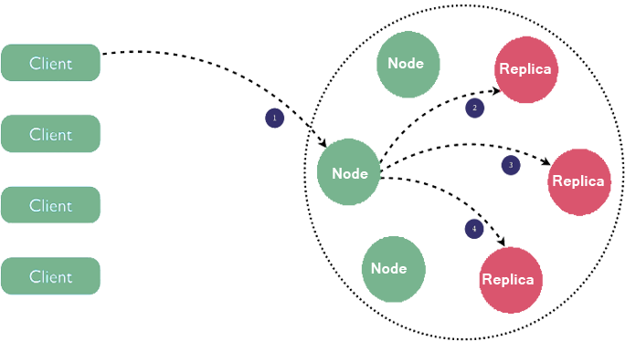
AWESOME REDUNDANCY & HA
Multi DC
Spark
CQL
Auto sharding
Wide rows

Slide 15
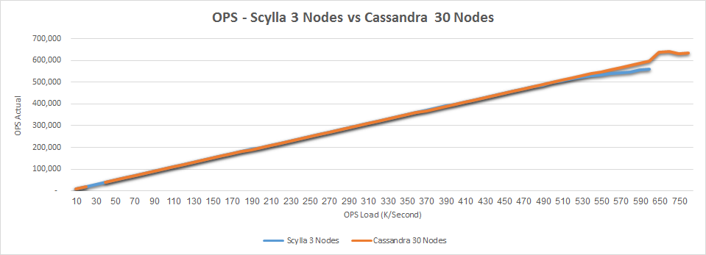
RESULTS: THROUGHPUT/SCALE UP

Slide 16
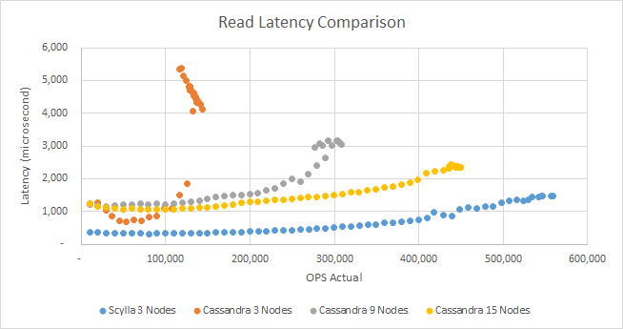
LATENCY - AVG

Slide 17
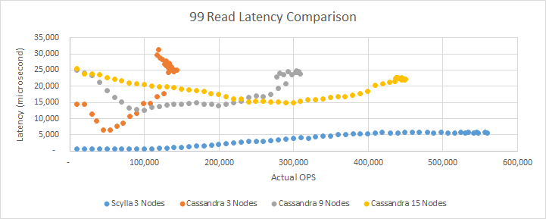
LATENCY - P99

Slide 18
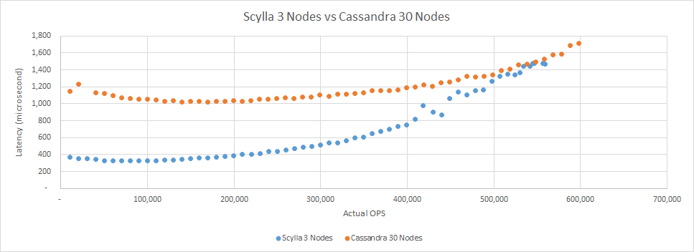
LATENCY - AVERAGE

Slide 19
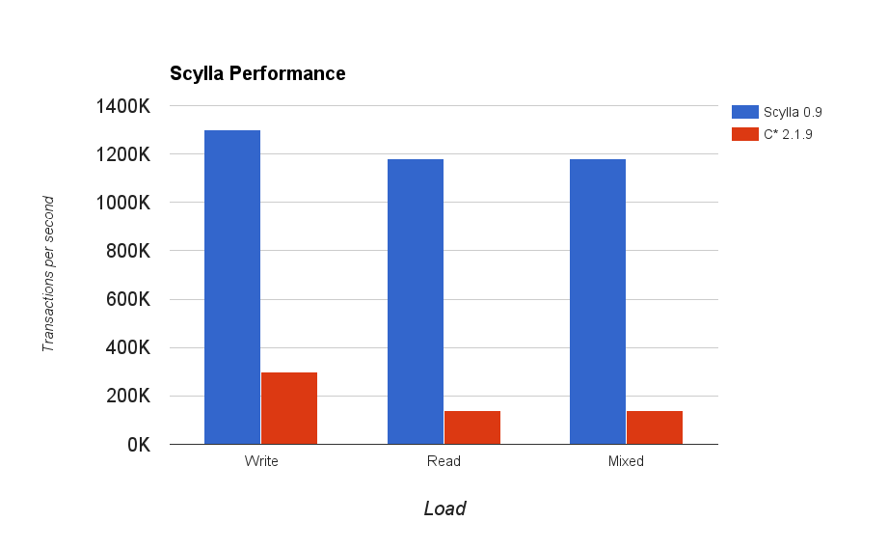
THROUGHPUT

Slide 20
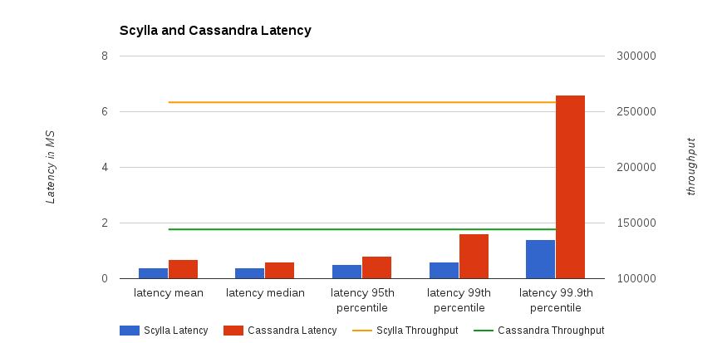
LATENCY

Slide 21
ScyllaDB Admin Philosophy
Self-tuning: internally manages resources
Efficient utilization of server hardware
High observability via monitoring counters
Cassandra compatible tooling

Slide 22
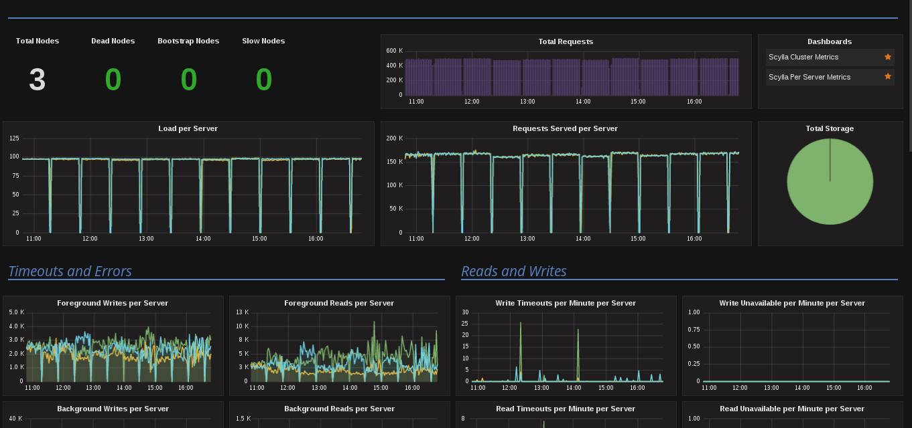
Monitoring Scylla

Slide 23
WHAT WOULD YOU DO WITH 1 MILLION TPS?
Shrink your cluster by a factor of X10
Handle traffic spikes
Get the most out of your data - Run more queries
Stop using caches in front of the database
Stop worrying about latency

Slide 24
AGENDA
Introduction to NoSQL
About Apache Cassandra
Introducing ScyllaDB
Compatibility
How it works
Roadmap
Closing

Slide 25
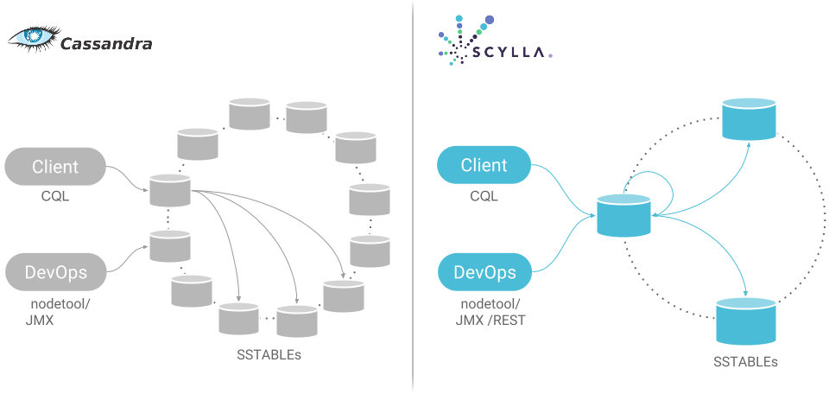
FULLY COMPATIBLE

Slide 26
Compatibility
SSTable file format
Configuration file format
CQL language
CQL native protocol
JMX management protocol
Management command line

Slide 27
FULLY COMPATIBLE
Uses Cassandra SSTables
Use your existing drivers
Use your existing CQL queries
Use your existing cassandra.yaml
Manage with nodetool or other JMX console
Use your existing code with no change
Copy over a complete Cassandra database
Works with the Cassandra ecosystem (Spark etc.)

Slide 28
Sharing the Ecosystem
Spark
Presto
Hadoop
KairosDB
...

Slide 29
Migrating your application
Stop-install-start
Simple
Incurs downtime
Double cluster
No downtime
Flip the switch when you like

Slide 30
Double cluster
Cassandra
CQL
proxy
App
Scylla

Slide 31
AGENDA
Introduction to NoSQL
About Apache Cassandra
Introducing ScyllaDB
Compatibility
How it works
Roadmap
Closing

Slide 32
TECHNOLOGY:
HOW IT WORKS

Slide 33
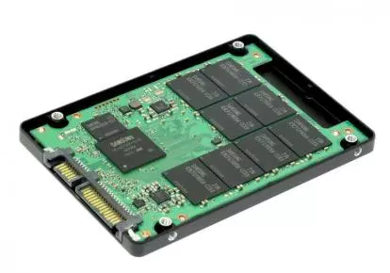

Slide 34
SCYLLA IS QUITE DIFFERENT
Shard-per-core, no locks, no threads, zero-copy
C++14, using Seastar framework
Our own efficient, DB-aware cache, not using Linux page cache
Max out all HW resources - NUMA friendly, multiqueue NICs, etc
Userspace I/O scheduler

Slide 35
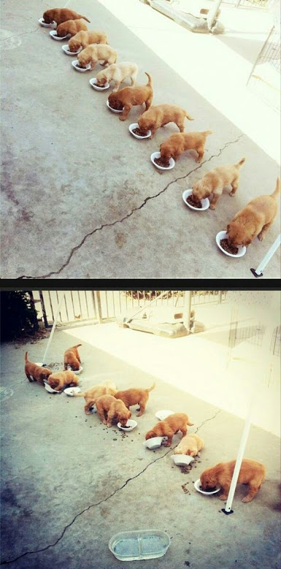
SCYLLA’S SHARD PER CORE
Threads
Shards
Notes:
http://aws.amazon.com/ec2/pricing/

Slide 36
SCYLLA DB: NETWORK COMPARISON
Traditional stack
SeaStar’s sharded stack
Core
Database
Cassandra
Application
No contention
Linear scaling
NUMA friendly
Application
queue
Application
Lock contention
Cache contention
NUMA unfriendly
queue
queue
queue
queue
threads
TCP/IP
TCP/IP
TCP/IP
TCP/IP
Kernel
Kernel
Task Scheduler
queue
queue
queue
Task Scheduler
queue
queue
queue
queue
queue
Task Scheduler
queue
queue
queue
queue
Scheduler
queue
smp queue
Memory
TCP/IP
Task Scheduler
queue
queue
queue
queue
smp queue
queue
queue
smp queue
queue
DPDK
smp queue
DPDK
DPDK
DPDK
Userspace
Userspace
Userspace
Userspace
Kernel (isn’t involved)
Kernel (isn’t involved)
Kernel (isn’t involved)
Kernel (isn’t involved)
NIC
Queue
NIC
Queues
NIC
Queue
NIC
Queue
NIC
Queue

Slide 37
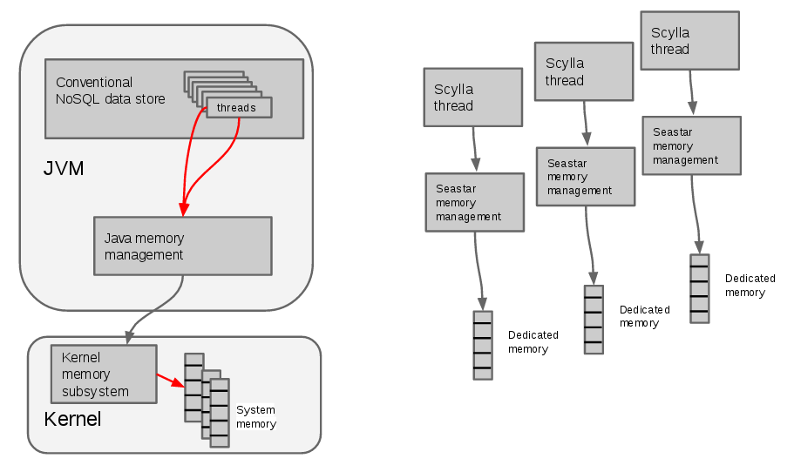
Scylla Memory Management
Notes:
http://aws.amazon.com/ec2/pricing/

Slide 38
Blasting out I/O operations
future<>
make_data_requests(digest_resolver_ptr resolver, targets_iterator begin,
targets_iterator end) {
return parallel_for_each(begin, end, [this, resolver =
std::move(resolver)] (gms::inet_address ep) {
return make_data_request(ep).then_wrapped([resolver, ep]
(future<foreign_ptr<lw_shared_ptr<query::result>>> f) {
try {
resolver->add_data(ep, f.get0());
} catch (...) {
resolver->error(ep, std::current_exception());
}
});
});
}
Notes:
http://aws.amazon.com/ec2/pricing/

Slide 39
Unified cache
Cassandra
Scylla
Key cache
Unified cache
On-heap /
Off-heap
Row cache
Linux page cache
SSTables
SSTables
Notes:
http://aws.amazon.com/ec2/pricing/

Slide 40
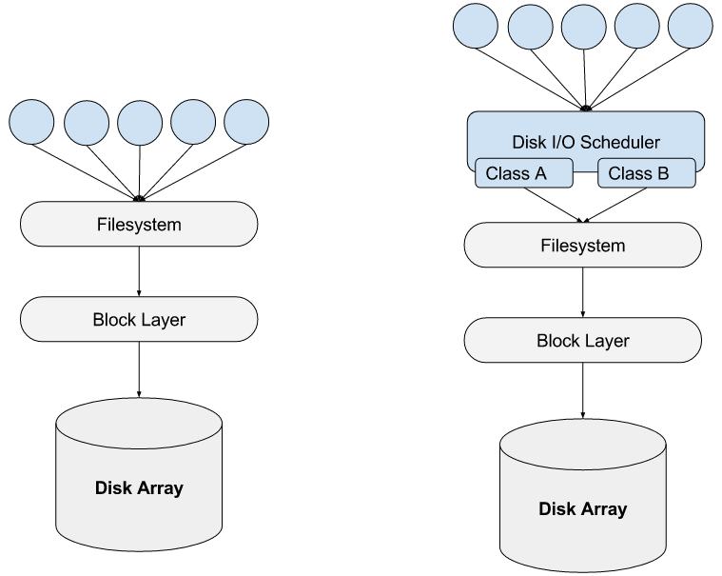
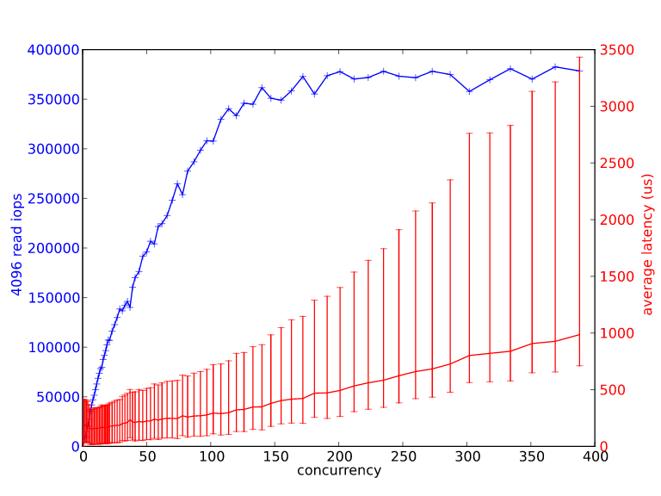
Scylla has an I/O scheduler
Scylla stack
Max useful disk concurrency
I/O gets
re-prioritized
here
Traditional stack
Notes:
http://aws.amazon.com/ec2/pricing/

Slide 41
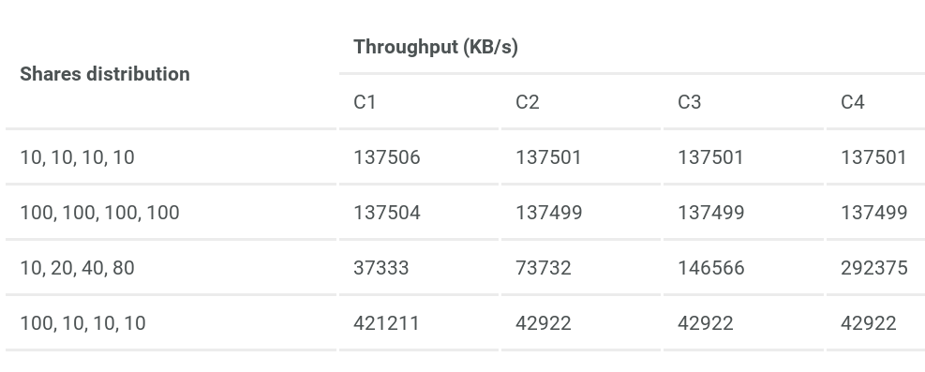
Scylla has an I/O scheduler
Notes:
http://aws.amazon.com/ec2/pricing/

Slide 42
AGENDA
Introduction to NoSQL
About Apache Cassandra
Introducing ScyllaDB
Compatibility
How it works
Roadmap
Closing

Slide 43
Rear-view mirror
1.0: 31 Mar 2016
General Availability
1.1: 17 May 2016
ALTER TABLE
User-defined types
Authentication, authorization, encryption
SSTable loader tool
1.2: Now…
ALTER KEYSPACE ...

Slide 44
Near-term
1.3: July 2016
Date-Tiered Compaction Strategy
CQL Tracing
Wide rows performance
1.4: August 2016
Thrift
Secondary index

Slide 45
Mid-term
Management console
REST API
Materialized views
Continuous repair

Slide 46
Longer term
In-database Analytics
Multi-tenancy
Storage-class memory

Slide 47
AGENDA
Introduction to NoSQL
About Apache Cassandra
Introducing ScyllaDB
Compatibility
How it works
Roadmap
Closing

Slide 49
How to interact
Download: http://www.scylladb.com
Twitter: @ScyllaDB
Source: http://github.com/scylladb/scylla
Mailing lists: scylladb-user @ groups.google.com
Company site & blog: http://www.scylladb.com

Slide 50
ScyllaDB.com
SCYLLA, NoSQL GOES NATIVE
Thank you.

